Slide 1
Conditional
Rendering

Slide 2
React doesn’t have if/else statements inside JSX.
Instead, we use conditional rendering to decide what to show.
Conditional rendering means displaying UI elements based on certain conditions or states.

Slide 3
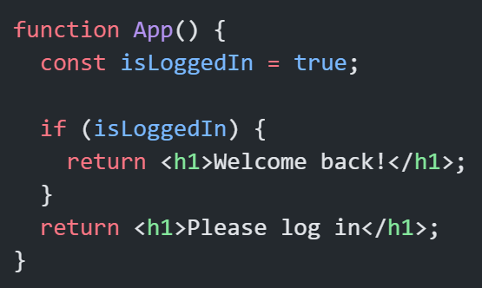
Using if/else:
React components can return different JSX depending on logic.
Note:
Don’t trying to use if inside JSX tags —it is not allowed.

Slide 4
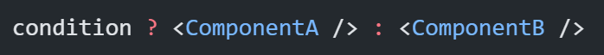
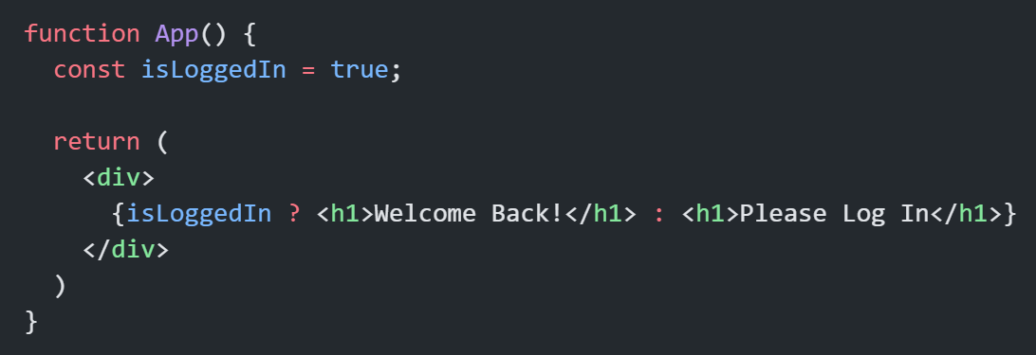
Using Ternary Operator (Inline Rendering)
Syntax:
Note:
Avoid complex ternaries with multiple ? : ? : ? — it reduces readability.
Example:

Slide 5
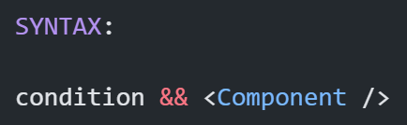
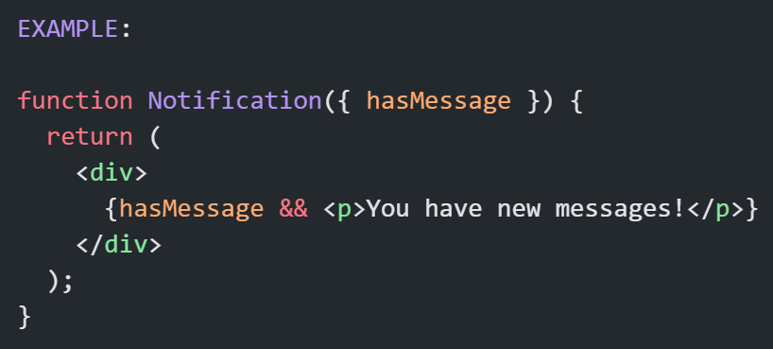
Logical AND (&&) Operator
Note:
If the condition is true → it renders the element.
If false → renders nothing.
Use case → When you only want to show something (not alternate options).

Slide 6
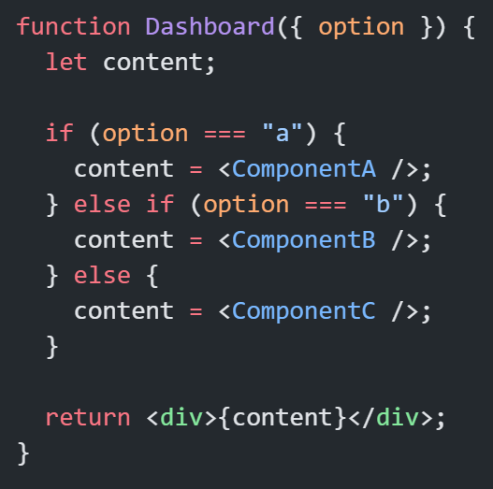
Conditional Rendering with Variables
Store JSX in a variable.
Helps keep return statement clean and readable.

Slide 7
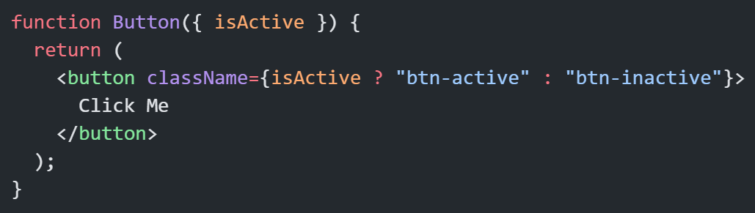
Conditional CSS or ClassName

Slide 8
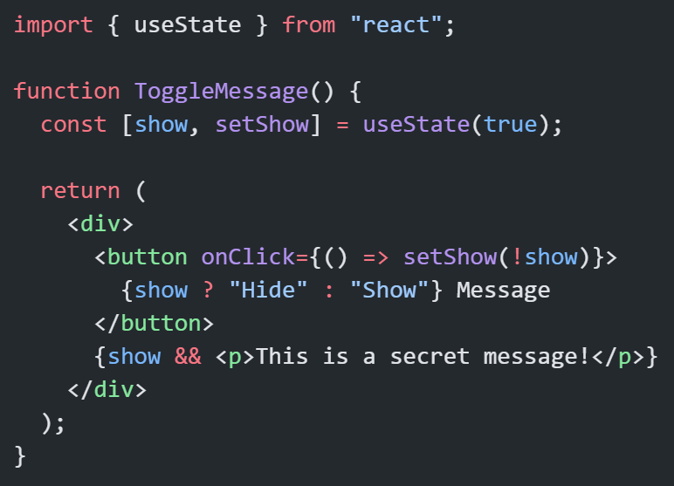
Conditional Rendering with State

Slide 9
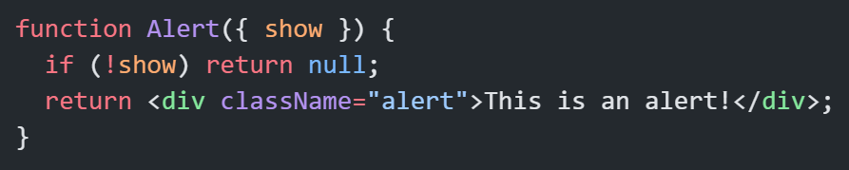
Returning null (Hide Completely)
Returning null means “render nothing”.
Common in modal or popup components.

Slide 10
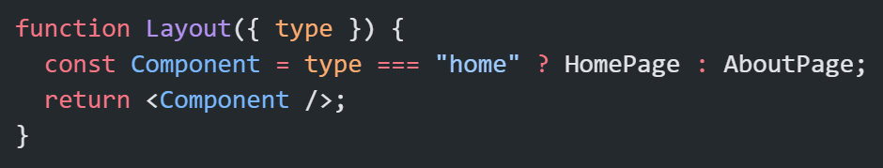
Advanced: Conditional Components
You can even conditionally select components themselves.
Useful for routing-like patterns or dynamic layouts.

Slide 11
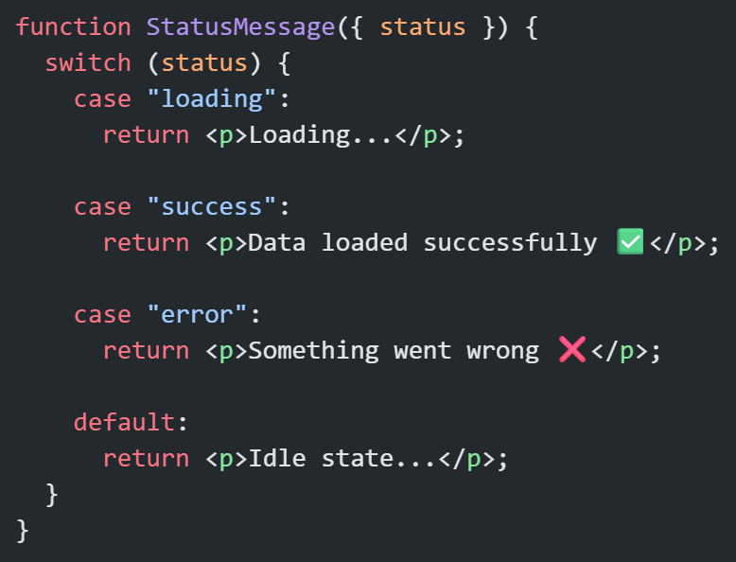
Using switch Statement
When you have 3 or more conditions, if/else becomes messy. That’s when switch makes your code cleaner and more readable.

Slide 12
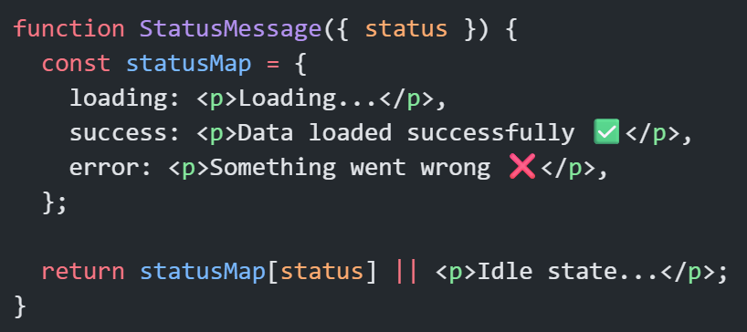
Using Mapping (Object Lookup)
For even more elegant and scalable conditional rendering —you can use object maps to store your UI patterns.

Slide 13
Common Beginner Mistakes
❌ Writing if inside JSX → use ternary or logical AND.
❌ Nesting too many ternaries → makes code unreadable.
❌ Forgetting to handle “else” case → empty UI.
❌ Using == instead of === → unexpected behavior.
❌ Forgetting return null → causes unnecessary rendering.

Slide 14
Tips
✅ Extract conditional logic into small functions.
✅ Keep JSX clean — logic outside, UI inside.
✅ Prefer readability over compactness.
✅ For multiple conditions, use switch or mapping.

Slide 15
Thank You

